Slide 1

MANAGING CLOUD SOLUTIONS
Course code- INT330
L T P :2 0 2
www.lpu.in Lovely Professional University

Slide 2
VISION & MISSION – SCHOOL
VISION:
To be a globally recognized school through excellence in teaching, learning, and research for creating Computer Science professionals, leaders, and entrepreneurs of the future contributing to society and industry for sustainable growth
MISSION:
M1: To build computational skills through hands-on and practice-based learning with measurable outcomes.
M2: To establish a strong connect with industry for in-demand technology driven curriculum.
M3: To build the infrastructure for meaningful research around societal problems.
M4: To nurture future leaders through research-infused education and lifelong learning.
M5:To create smart and ethical professionals and entrepreneurs who are recognized globally.

Slide 3


DELIVERY METHOD
Lectures- 2
Tutorial- 0
Practical- 2
Credits- 3
www.lpu.in Lovely Professional University

Slide 4
COURSE WEIGHTAGE
Attendance -- 05 Marks
CA -- 45 Marks
ETE -- 50 Marks
Total - 100 Marks
www.lpu.in Lovely Professional University

Slide 5
COURSE OUTCOMES
Course Outcome | Description
CO 1 | describe cloud basics, billings and various Cloud services offered by AWS
CO 2 | apply AWS global infrastructure knowledge and IAM principles to secure and manage AWS accounts effectively
CO 3 | understand best practices for securing cloud accounts and learn the implementation of VPC through console
CO 4 | analyze and optimize compute solutions using AWS services for efficient and scalable application deployment
CO 5 | examine the appropriate storage and database solutions in AWS Platform
CO 6 | assess the benefits of Auto scaling and Elastic Load Balancer features in AWS Platform

Slide 6
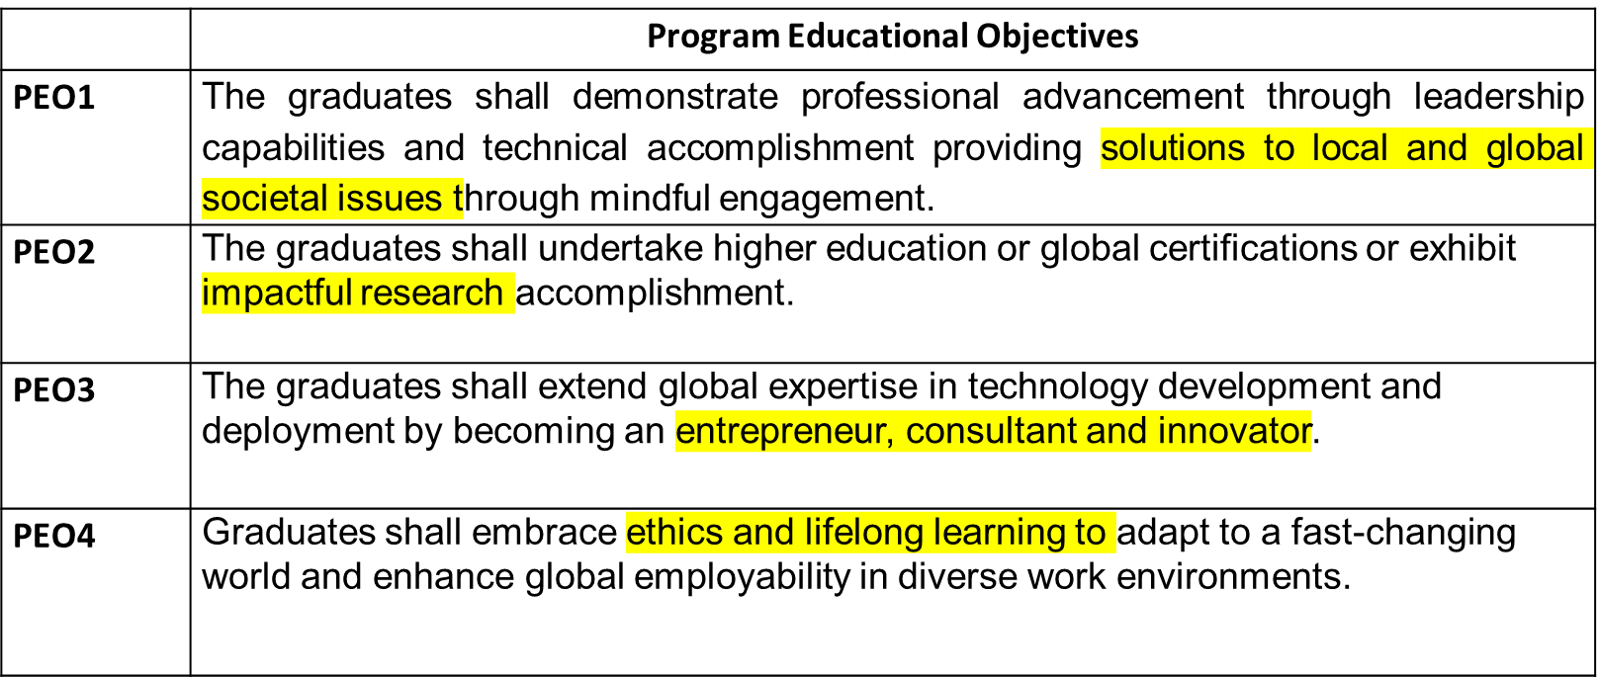
PROGRAM EDUCATIONAL OUTCOMES
www.lpu.in Lovely Professional University

Slide 7
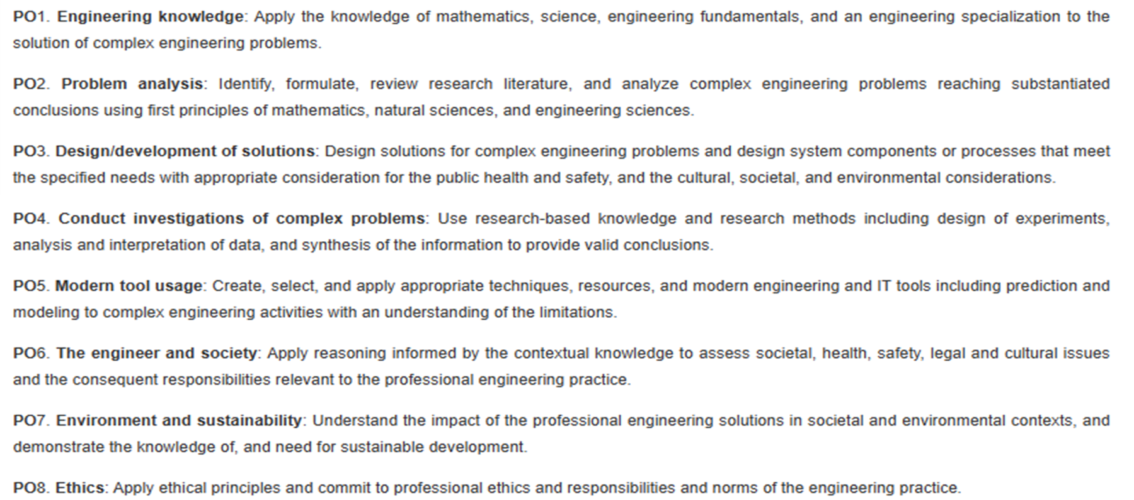
PROGRAM OUTCOMES
www.lpu.in Lovely Professional University

Slide 8
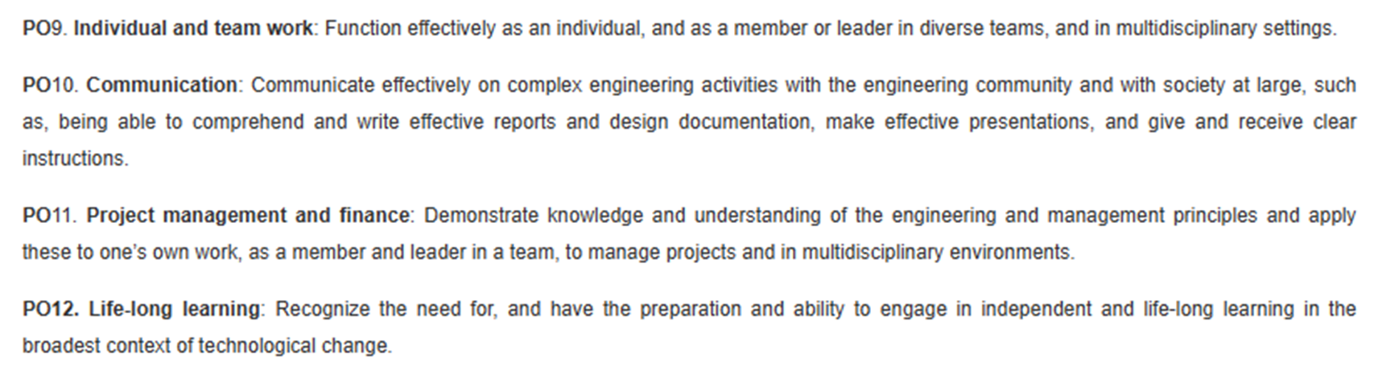
PROGRAM OUTCOMES
www.lpu.in Lovely Professional University

Slide 9
PROGRAM SPECIFIC OUTCOMES
PSO1::Apply acquired skills in software engineering, networking, security, databases, intelligent systems, cloud computing and operating systems to adapt and deploy innovative software solutions for diverse applications.
PSO2::Apply diverse IT skills to design, develop, and evaluate innovative solutions for business environments, considering risks, and utilizing interdisciplinary knowledge for efficient real-time projects benefiting society.
www.lpu.in Lovely Professional University

Slide 10

Bloom’s taxonomy
www.lpu.in Lovely Professional University

Slide 11
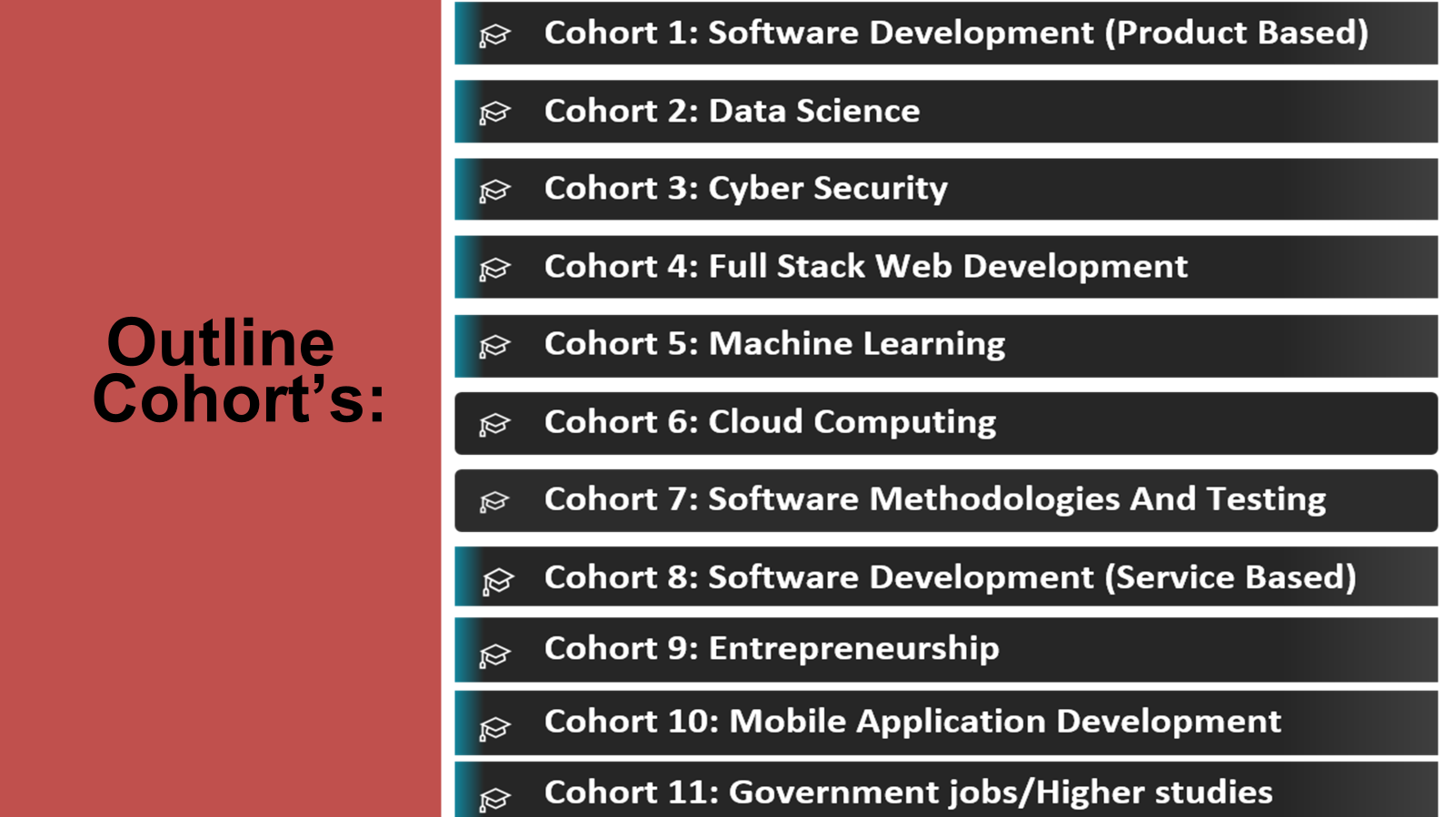

Slide 12
CONTENTS
Unit I
Cloud Concepts Overview : Introduction to cloud computing, Introduction to AWS, Moving to the AWS Cloud, Cloud Economics and Billing, Fundamentals of pricing, Total cost of ownership, AWS Organizations, AWS billing and cost management
Unit II
AWS Global Infrastructure Overview : AWS global infrastructure, AWS services and service categories, AWS Management Console, AWS shared responsibility model, AWS IAM, Securing a new AWS account
Unit III
Cloud Security and Networking : Securing accounts, Securing data, Working to ensure compliance, Networking basics, Amazon VPC, VPC networking, Amazon VPC Console, VPC security, Route 53, CloudFront

Slide 13
CONTENTS
Unit IV
Compute : Compute services overview, Amazon EC2, Amazon EC2 Versus Managed Services, Amazon EC2 cost optimization, Container services, Introduction to AWS Lambda, Introduction to AWS Elastic Beanstalk
Unit V
Storage and Databases : Amazon Elastic Block Store Console, AWS S3, AWS EFS, AWS S3 Glacier, Storage Technology Selection, Amazon RDS, Build a Database Server, Amazon DynamoDB, Amazon Redshift, Amazon Aurora
Unit VI
Cloud Architecture : AWS Well-Architected Framework design principles, Operational excellence, Security, Reliability, Performance efficiency, Cost optimization, Reliability & high availability, AWS Trusted Advisor Elastic Load Balancing, Amazon CloudWatch, Amazon EC2 auto scaling

Slide 14
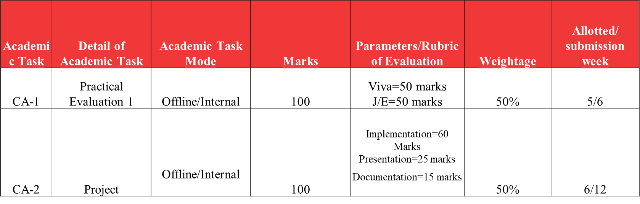
EVALUATION CRITERIA
Ca Category :: A0202

Slide 15
EVALUATION CRITERIA
Note:
MTE: There will be NO MTE applicable for this course.
2. ETP: There will be ETP applicable for this course.
Viva-30 marks
Written-20 marks
J/E=50 marks
3. Both CA’S are mandatory.
www.lpu.in Lovely Professional University

Slide 16
STAR COURSE
Hands-on Practice:
This course helps to Assess understanding of core AWS services
Identify knowledge gaps for further study
Apply service knowledge to real-world scenarios
Prepare for AWS cloud Practitioner certification exam
Reinforce learning through immediate feedback and explanations

Slide 17
OPEN EDUCATIONAL RESOURCE
Unit mapped | Broad topic/Sub Topic | OER Type | Title of OER | *%age unit mapped with OER (approx) | Source URL
Unit 1 | Cloud Concepts Overview | Reading material (pdf), MOOC | AWS Cloud Computing | 100 % | https://www.w3schools.com/aws/aws_cloudessentials_cloudcomputing.php, https://www.coursera.org/learn/aws-cloud-practitioner-essentials, https://www.udemy.com/course/aws-certified-cloud-practitioner-training-course/
Unit 2 | AWS Global Infrastructure Overview | Reading material (pdf), MOOC | Introduction to AWS Global Infrastructure | 100% | https://www.w3schools.com/aws/aws_cloudessentials_awscert.php , https://www.coursera.org/learn/aws-cloud-practitioner-essentials, https://www.udemy.com/course/aws-certified-cloud-practitioner-training-course/
Unit 3 | Cloud Security and Networking | Reading material (pdf) , MOOC | AWS Cloud Security | 100% | https://www.w3schools.com/aws/aws_cloudessentials_awscert.php , https://www.coursera.org/learn/aws-cloud-practitioner-essentials, https://www.udemy.com/course/aws-certified-cloud-practitioner-training-course/

Slide 18
OPEN EDUCATIONAL RESOURCE
Unit 4 | Compute | Reading material (pdf), MOOC | AWS Cloud EC2 | 100 % | https://www.w3schools.com/aws/aws_cloudessentials_awscert.php , https://www.coursera.org/learn/aws-cloud-practitioner-essentials, https://www.udemy.com/course/aws-certified-cloud-practitioner-training-course/
Unit 5 | Storage and Databases | Reading material (pdf), MOOC | AWS Storage and Databases | 100 % | https://www.w3schools.com/aws/aws_cloudessentials_awscert.php , https://www.coursera.org/learn/aws-cloud-practitioner-essentials, https://www.udemy.com/course/aws-certified-cloud-practitioner-training-course/
Unit 6 | Cloud Architecture | Reading material (pdf), MOOC | AWS Well-Architected Framework | 100 % | https://www.w3schools.com/aws/aws_cloudessentials_awscert.php , https://www.coursera.org/learn/aws-cloud-practitioner-essentials, https://www.udemy.com/course/aws-certified-cloud-practitioner-training-course/

Slide 19

www.lpu.in Lovely Professional University

